Slide 1

COLREGs-based Situation Awareness for Marine Vessels - a Discrete Event Systems Approach
Peter Nicholas Hansen*, Dimitrios Papageorgiou*, Mogens Blanke*, Roberto Galeazzi*,
Marie Lützen**, John Mogensen**, Mette Bennedsen**, Dorthe Hansen**
* Department of Electrical Engineering, Technical University of Denmark, 2800 Lyngby, Denmark
** Svendborg International Maritime Academy, 5700 Svendborg, Denmark
This research is results of the ASAN (Autonomous Situation Awareness for Navigation) and
ShippingLab-Autonomy projects. The first is sponsored by 3 private foundstions: The Danish Maritime Fund, Orients Fund and Lauritzen Foundation. Shippinglab is sponsored by The Danish Innovation Fund and the said private funds.
1

Slide 2
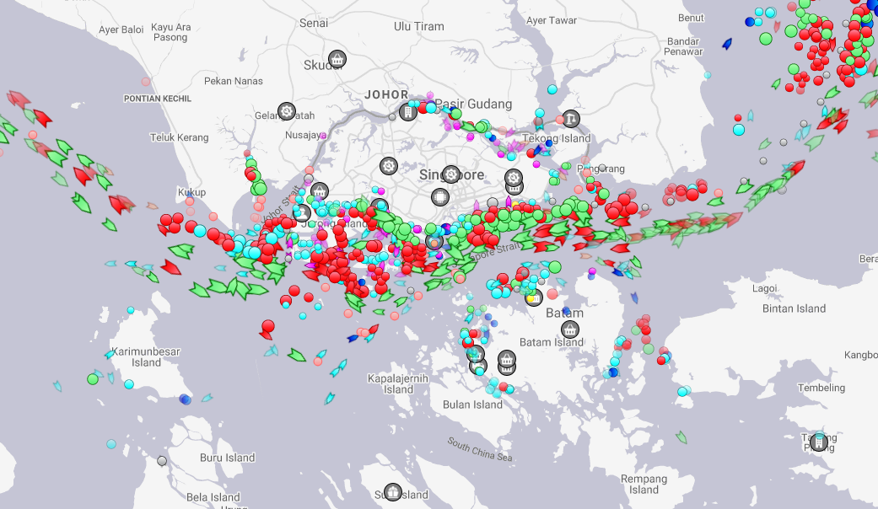
Motivation - Navigational Process
To safely navigate a ship, a navigator needs to:
Collect data from radar, AIS, ECDIS etc.
Visually confirm the sensory information
Identify possible threats & filter out irrelevant vessels/targets
However, this can prove difficult and time consuming when operating in high traffic areas, e.g. Singapore strait
Screenshot of Singapore Strait on MarineTraffic.com

Slide 3
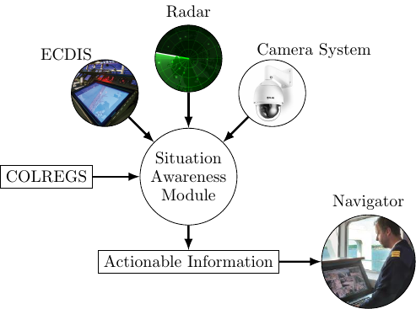
Motivation - Autonomous navigation at sea
Goals
Provide decision support for navigators onboard
Enable temporarily unmanned bridge using autonomous supervision
Objectives
Collect and process camera, radar & ECDIS data, etc.
Create situational awareness from the sensory input
Suggest COLREGs-compliant actions based on the situation
3

Slide 4
Situational Awareness – What is it?
Situational Awareness can be divided into three parts¹:
Focus of this paper
Environment
Situational Awareness
Decision Making
Perception
Understanding
Anticipation
¹ Endsley, M.R. (1995). Toward a theory of situation awareness. Human Factors: The Journal of the Human Factors and Ergonomics Society, 37, 32-64.
Notes:
According to Endsley, situational awareness can be divided into three parts:
1) Perception: The

Slide 5
Automata-based framework for Situational Awareness
Situation assessment and decision making are event-driven
Discrete Event Systems (DES) theory natural framework
Automata use language and graph theory → intuitive and easy to interpret
Sequences of events
Event-based actions
Framework consists of four automata:
Perception Automaton
Understanding Automata
Anticipation Automata
Coordinator Automaton

Slide 6
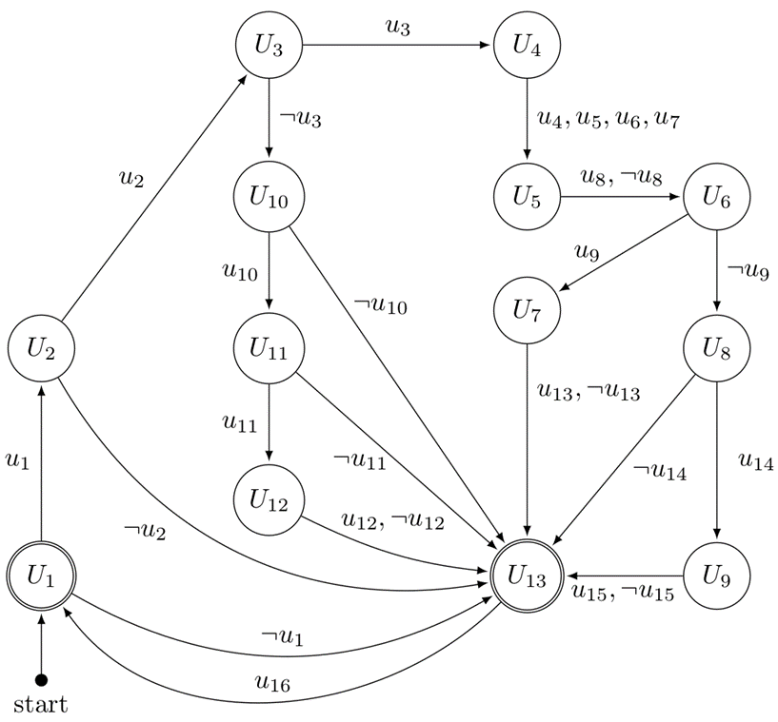
Automata-based framework for Situational Awareness
Understanding Automaton
Responsible for assigning semantic meaning to sensory input
Each state is a diagnostic test for a detected object
Each event is the result of a diagnostic test
Example
U₁ : The objects CPA is compared to a "comfort zone" distance d_{req}
U₄ : Calculate own ship bearing relative to the object

Slide 7
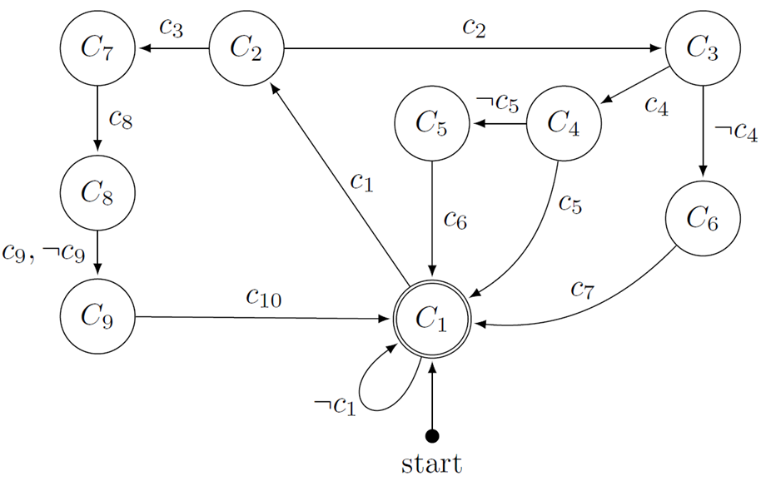
Automata-based framework for Situational Awareness
Coordinator Automaton
Responsible for instantiating and updating Understanding and Anticipation automata
Main coordinating module of the framework
Acts as an intermediary layer for communication between automata instances and the rest of the autonomous system
Example
C₂ : Check type of new report
C₃ : Check if detected object already being tracked

Slide 8
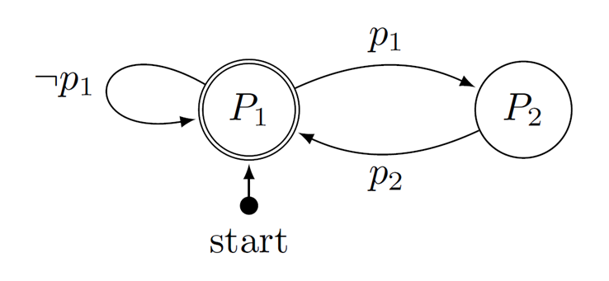
Automata-based framework for Situational Awareness
Perception Automaton
Responsible for reporting newly detected objects to the Coordinator
Used as a representation of the functionalities of the Perception module
Example
P₁ : Scan for objects
p₁ : New object detected

Slide 9
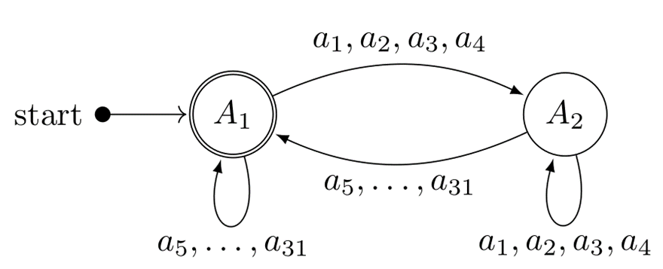
Automata-based framework for Situational Awareness
Anticipation Automaton
Predict required behavior of own ship, based on the sematic understanding and COLREGs
Implemented behaviors:
A₁ : "Stand-on" - Keep course and speed
A₂ : "Give-way" - Yield to target vessel
Events are generated by the Coordinator
Example
a₁ : Port side crossing → Own ship must give way (State A₂)
COLREGS apply when there is a risk of collision:
Closest Point of Approach (CPA) is too close
Time to CPA (TCPA) is close

Slide 10
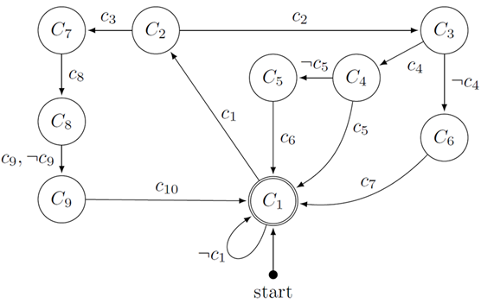
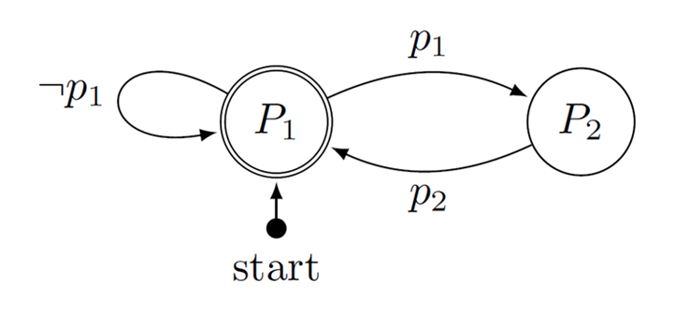


Automata-based framework for Situational Awareness
The proposed framework consists of:
A single Coordinator automaton
A Single Perception automaton
Multiple, linked Understanding and Anticipation automata
Each Understanding and Anticipation automaton pair operates on data from a single target object
Perception
Coordinator
….
Understanding & anticipation pairs

Slide 11
Automata-based framework for Situational Awareness
The proposed framework consists of:
A single Coordinator automaton
A Single Perception automaton
Multiple, linked Understanding and Anticipation automata
Each Understanding and Anticipation automaton pair operates on data from a single target object
Perception
Coordinator
….
….
Understanding & anticipation pairs

Slide 12
Automata-based framework for Situational Awareness
Each event in the anticipation automaton, represents a unique situation, which is encoded as a unique string:
Report from Understanding automata
Appended word from Coordinator
Stand-on
Target is overtaking
Target is power-driven
Report comes from the Understanding Automaton

Slide 13
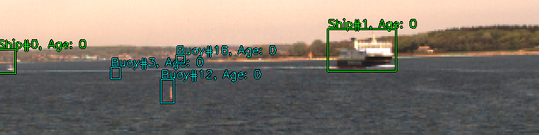


Example Scenario – Head on
TV1 is a power-driven vessel
TV1 is detected, Perception automaton reports to Coordinator
Coordinator instanciates new Understanding & Anticipation automaton for TV1
TV1
c₁
c₂
Spawn Understanding and Anticipation Automata
Event: p₁
¬c₄
c₇
OS

Slide 14


Example Scenario – Head on
TV1 violates CPA boundary, but not TCPA boundary.
Understanding automaton starts testing TV1 conditions
TV1
Event: u₁
¬u₂
c₁
c₃
c₈
c₉
c₁₀
a₇
Stand-on
OS

Slide 15
Example Scenario – Head on
TV1 moves closer and now violates both CPA and TCPA boundaries
TV1
c₃
c₈
c₉
a₇
Event: u₁
u₃
u₅
u₈
¬u₉
u₁₄
u₁₅
c₁
c₁₀
u₂
Give-way
OS

Slide 16
Conclusions and future work
Separation of situational awareness from decision making
Multiple automata that communicate through a Coordinator
Coordinator enables handling of multi-vessel scenarios
Future work
Higher-complexity scenarios
Multi-vessel decision making and path planning

Slide 17
Thank you for your attention
Department of Electrical Engineering, Technical University of Denmark,
Peter Nicholas Hansen, pnha@elektro.dtu.dk
Dimitrios Papageorgiou, dimpa@elektro.dtu.dk
Mogens Blanke, mb@elektro.dtu.dk
Roberto Galeazzi, rg@elektro.dtu.dk
Svendborg International Maritime Academy
Marie Lützen, mal@simac.dk
John Mogensen, jmo@simac.dk
Mette Bennedsen, mrb@simac.dk
Dorthe Hansen, doh@simac.dk
17

